Slide 1
DUVAL’S TRIANGLE 1 version 1.0
1

Slide 2
TABLE OF CONTENTS
1.0 INTRODUCTION
1.1 Purpose
1.2 Target Audience
1.3 Scope
1.4 System Requirements
2.0 PROCEDURE
2.1 Display
2.2 Installation
2.3 Configuration
PI Maximo Integration | Rev 1.0

Slide 3
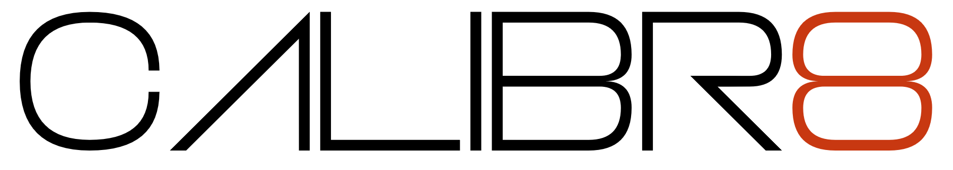
1.0 INTRODUCTION
1.1 Purpose
This Document provides information on how to use Duvals Triangle 1 which can be used to monitor the Mineral Oils of the transformer.
1.2 Target Audience
The Target Audience of this system is the Engineering Group.
1.3 Scope
The Scope of the project is to develop a PI Vision Extension that will display Duvals triangle 1.
1.4 System Requirements
PI Client Tools:
- PI Vision
PI Maximo Integration | Rev 1.0

Slide 4
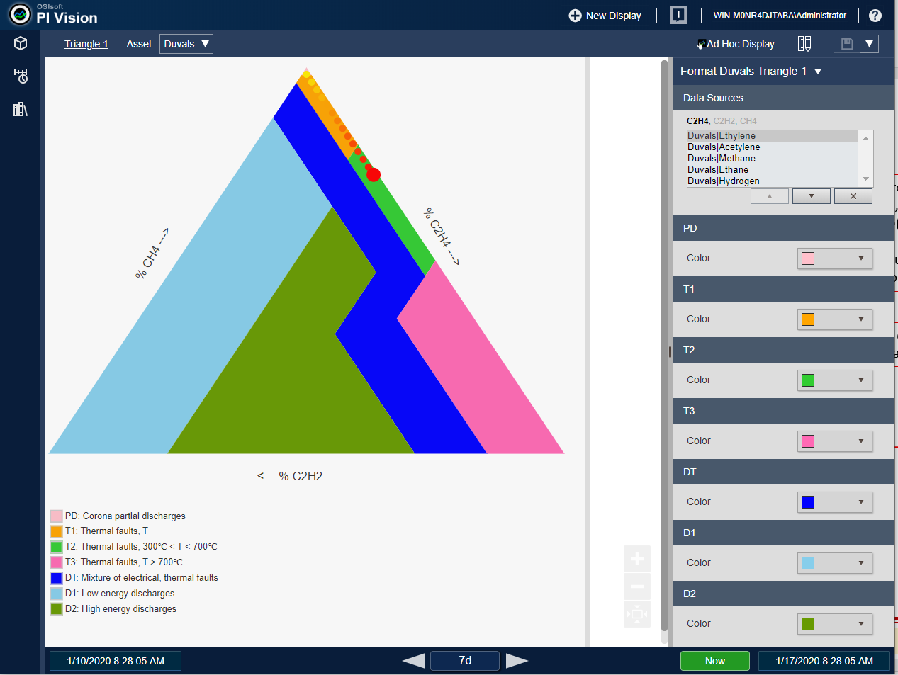
2.1 Display
PI Maximo Integration | Rev 1.0

Slide 5
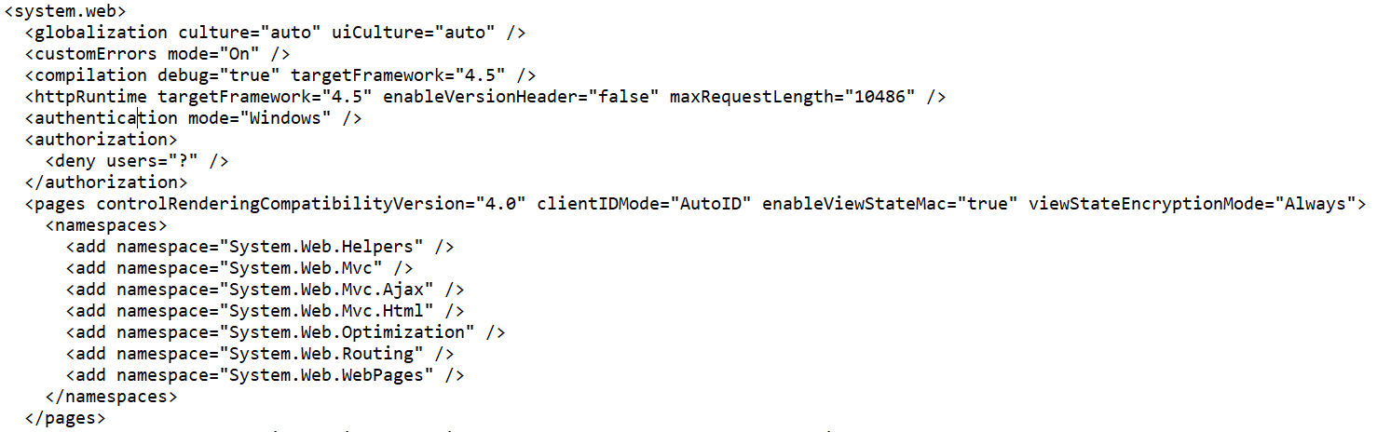
2.2 Installation
Go to PI Vision Directory and open the file web.config and make sure that the value of the debug mode is true. After changing anything in web.config, make sure to restart the IIS in PI Vision server.
PI Maximo Integration | Rev 1.0

Slide 6
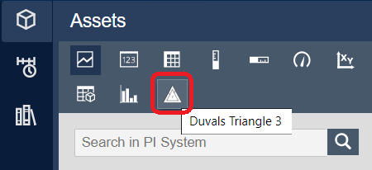
2.2 Installation
Extract the zip file that will be give by calibr8
Copy duvals.svg to {PI Vision Directory}\Images
Copy moment.js and folders d3, duvals inside {PI Vision Directory}\Scripts\app\editor\symbols\ext\libraries
Copy the following files to {PI Vision Directory}\Scripts\app\editor\symbols\ext
Sym-duvalst1.js
Sym-duvalst1-template.html
Sym-duvalst1-config.html
Refresh PI Vision and check if the icon is included in the Symbols List.
Start creating a display using the symbol.
PI Maximo Integration | Rev 1.0

Slide 7
2.3 Configuration
Make sure that the Ethylene(C2H4) attribute is on the first item, followed by Acetylene(C2H2) and Methane(CH4).
You may use the buttons below to Reorder or Remove the attributes mapped on the display
This is to configure the color of each triangle Region(Fault).
PI Maximo Integration | Rev 1.0

